Slide 1
Signed Networks Similarity
MA 653: Network Science
Instructor: Ashok Singh Sairam
ashok@iitg.ac.in

Slide 2
Signed edges
In social networks, edges can be annotated as positive or negative
Positive → Friends
Negative → Enemies
Note that a negative edge represents people who interact, but in a negative way
It is not the same with the absence of an edge
A network with positive and negative labels on its edges is called signed network
The corresponding edges are called signed edges

Slide 3
Triadic balance: the local view
A triad in a graph is a subgraph of three nodes
A triad is balanced iff there is an even number of negative signs
Unstable configurations appear far less times in real social networks
One can enumerate similar configurations of longer loops.
w
w
w
w
+
+
-
-
-
+
-
-
u
+
v
u
+
v
u
+
v
u
-
v
(a) Balanced
(b) Balanced
(c) Unbalanced
(d) Unbalanced

Slide 4
Ex: International relations
In the 1971 Bangladesh war, why did US support Pakistan? => as they were friends (+).
Ban
-
+
Pak
-
India
+
-?
-
+?
China
+
+
-
USA
USSR

Slide 5
Structural balance
Networks containing only loops with even number of minus signs are said to show structural balance
This is also true for loops of length greater than three
Harary proved an important consequence of structural balance in networks
A balanced network can be divided into connected groups of vertices such that all connections between members of the same group are positive and all connections between members of different groups are negative
Groups can consist even of a single node
A network that can be divided into groups as per the above theorem are called clusterable
Hence, a balanced network is clusterable as well

Slide 6
Ex:Balanced clusterable network
d
e
+
Every loop contains even number of minus sign. Dotted lines indicate the division of network into clusters
-
f
-
-
-
-
a
+
+
b
c

Slide 7
Harary’s Theorem
Intuitively, the theorem can be stated as
Given a signed, balanced graph, the vertex set N can be partitioned into two subsets N₁ and N₂ in such a way that every positive edge connects vertices from one and the same subset and every negative edge connects vertices from different subsets.

Slide 8
Note
The structural balance theorem states that a balanced network is clusterable
The opposite is NOT true
We can cluster the network in 3 clusters
However, the network is not balanced

Slide 9
Similarity
A central concept in social network analysis is that of vertex similarity
Similarity between vertices can be defined based on their attributes
Ex: Similar webpages, commercial matchmaking sites, etc
However, our focus is on determining similarity using the information contained in the network structure
There are two measures of constructing network similarity
Structural equivalence
Regular equivalence

Slide 10
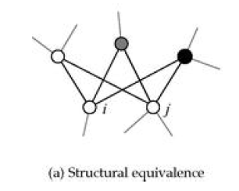
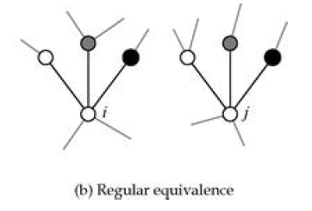
Structural vs. Regular equivalence
Vertices i and j are structurally equivalent if they share many of the same neighbors.
Cosine similarity, Pearson coefficients
Vertices i and j are regularly equivalent if their neighbors are themselves equivalent (indicated here by the different shades of vertices).

Slide 11
Cosine similarity
Straightforward metric for structural equivalence between nodes i and j, would be to measure the number of common neighbors:
However, what is a high value for n?
We need to somehow normalize this quantity
One approach: Normalize by total #vertices (maximum possible neighbors)
Dis: Nodes with low degree are bound to low similarities
Better approach: allow for the varying degree of vertices
Cosine similarity inspired by geometry
The inner product of two vectors x and y is given by:

Slide 12
Cosine similarity
Rearranging we have:
Considering as the two vectors the i-th and j-th rows (or columns) of the adjacency matrix we get the cosine similarity of the two vertices:
where ki is the degree of vertex i
Therefore, the cosine similarity normalizes the number of common neighbors by the geometric mean of the degrees of the nodes

Slide 13
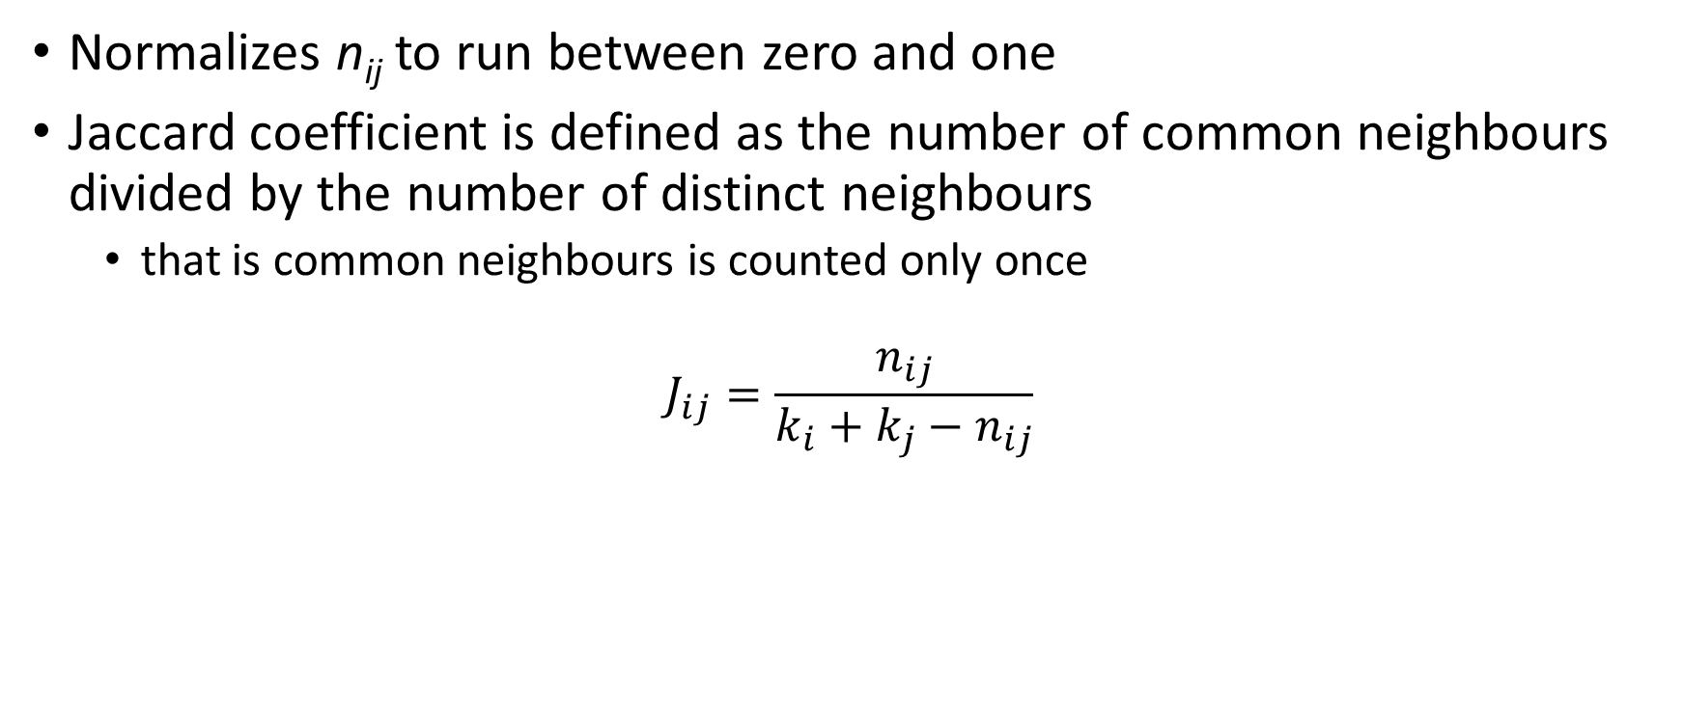
Jaccard Coefficient
Normalizes n_{ij} to run between zero and one
Jaccard coefficient is defined as the number of common neighbours divided by the number of distinct neighbours
that is common neighbours is counted only once
$$J_{ij}=\frac{n_{ij}}{k_{i}+k_{j}−n_{ij}}$$

Slide 14
Pearson coefficients
An alternative way to normalize the count of common neighbors
vertices chose their neighbors at random
If the degrees of vertices i and j are k_{i} and k_{j} respectively, then if connections were made at random the expected number of common neighbors is: k_{i}k_{j}/n
A reasonable metric is then the difference between the actual number of common neighbors and the expected one

Slide 15
Pearson coefficients
The quantity is positive if i and j
have more neighbors as expected
at random
where <Ai> denotes the mean n^(−1)*∑ A(ik) of the elements of the ith row of the adjacency matrix
We further normalize the above quantity with the maximum value of the covariance between the i-th and j-th row of the adjacency matrix
This is the variance of i-th or j-th row (they are both equal)

Slide 16
Other metrics of structural equivalence (1)
We can normalize the number of common neighbors not by subtracting the expected number but by dividing

Slide 17
Other metrics of structural equivalence (2)
Euclidean distance
#vertices that are neighbors of i but not of j
It is a dissimilarity measure since it is larger for vertices that differ more
We can normalize it by the maximum possible distance (all neighbors of i and j are different)

